Slide 1
Week 8
Robot Kinematics
Youngjoon Han
young@ssu.ac.kr
본 강의 자료는 아래 강의자료들을 편집하여 제작하였음
(1)http://ce.aut.ac.ir/~shiry/lecture/robotics
(2)http://web.cecs.pdx.edu/~mperkows/CLASS_479

Slide 2
Outline
Review
  Manipulator Specifications
  Homogeneous Matrix
Denavit-Hartenberg (D-H) Representation
Kinematics Equations
Inverse Kinematics

Slide 3
Review
Manipulator, Robot arms, Industrial robot
  A chain of rigid bodies (links) connected by joints (revolute or prismatic)
Manipulator Specification
  DOF
  Workspace, Payload
  Precision
  Repeatability
How accurately a specified point can be reached
How accurately the same position can be reached if the motion is repeated many times

Slide 4
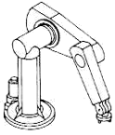
Degrees of Freedom
The degrees of freedom of a rigid body is defined as the number of independent movements it has.
The number of :
Independent position variables needed to locate all parts of the mechanism,
Different ways in which a robot arm can move,
Joints
Notes:
Quiz: Humans have 4 DOF for each fingers. The human finger has 3 joints,

Slide 5

DOF of a Rigid Body
In a plane
In space

Slide 6
Degrees of Freedom
3 position
3D Space = 6 DOF
3 orientation
In robotics:
DOF = number of independently driven joints
positioning accuracy
As DOF
computational complexity
cost
flexibility
power transmission is more difficult

Slide 7

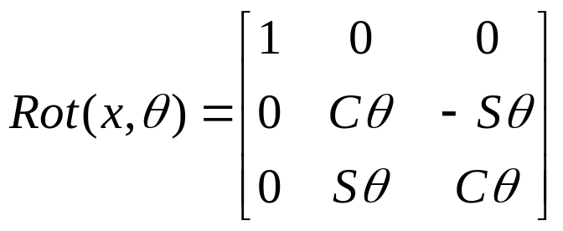
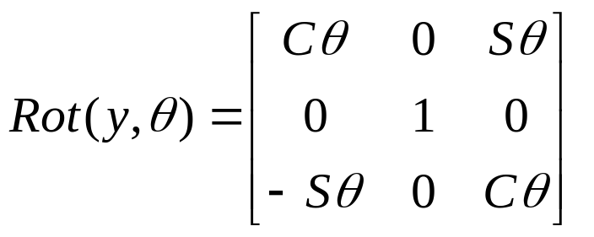
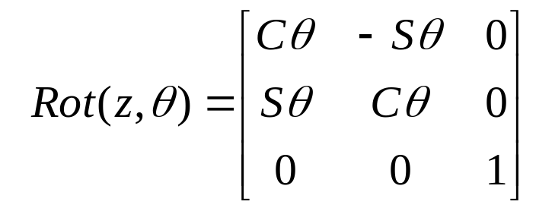
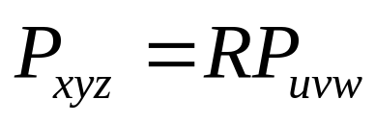
Basic Rotation Matrices
  Rotation about x-axis with
  Rotation about y-axis with
  Rotation about z-axis with

Slide 8
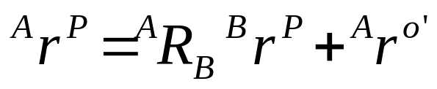
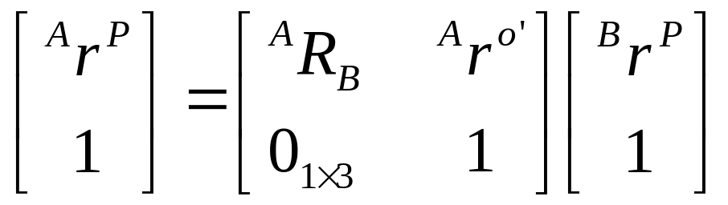
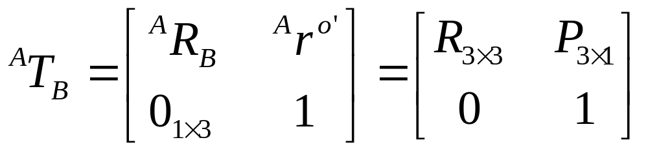
Review
Coordinate transformation from {B} to {A}
Homogeneous transformation matrix
Rotation matrix
Position vector
Scaling

Slide 9
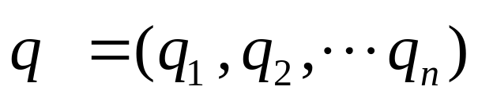
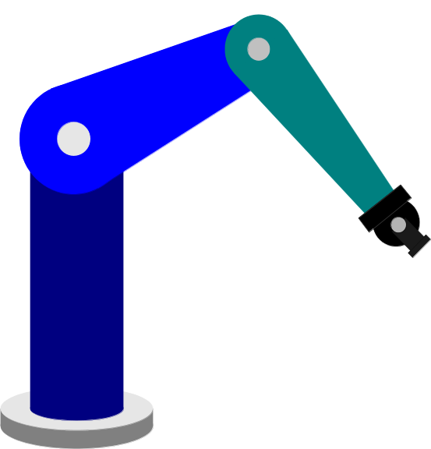

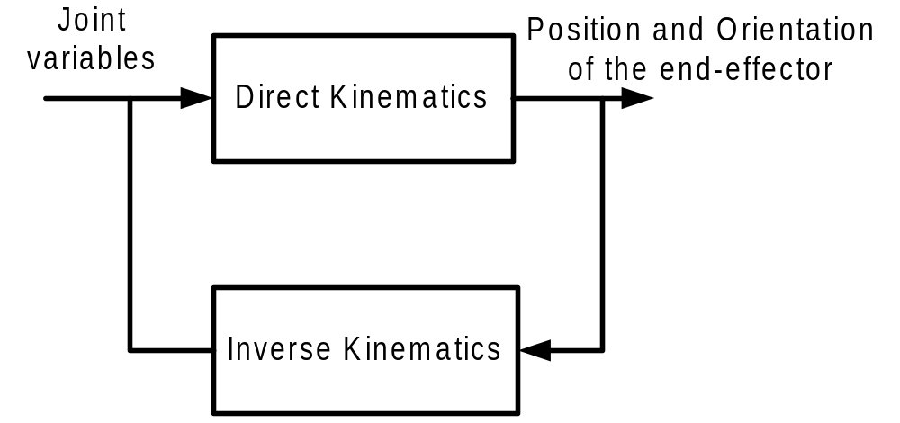



Kinematics Model
Forward (direct) Kinematics
Inverse Kinematics

Slide 10
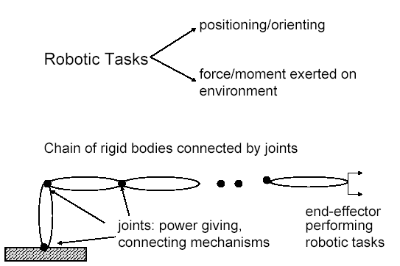
Robot Links and Joints

Slide 11
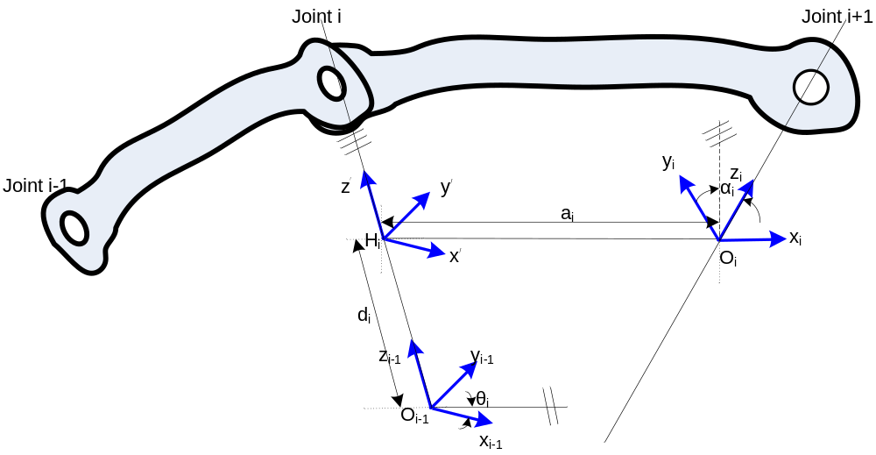
Denavit-Hartenberg Notation

Slide 12




Denavit-Hartenberg Convention
Number the joints from 1 to n starting with the base and ending with the end-effector.
Establish the base coordinate system. Establish a right-handed orthonormal coordinate system at the supporting base with axis lying along the axis of motion of joint 1.
Establish joint axis. Align the Z_{i} with the axis of motion (rotary or sliding) of joint i+1.
Establish the origin of the ith coordinate system. Locate the origin of the ith coordinate at the intersection of the Z_{i} & Z_{i-1} or at the intersection of common normal between the Z_{i} & Z_{i-1} axes and the Z_{i} axis.
Establish X_{i} axis. Establish or along the common normal between the Z_{i-1} & Z_{i} axes when they are parallel.
Establish Y_{i} axis. Assign to complete the right-handed coordinate system.
Find the link and joint parameters

Slide 13




Link and Joint Parameters
Joint angle : the angle of rotation from the X_{i-1} axis to the X_{i} axis about the Z_{i-1} axis. It is the joint variable if joint i is rotary.
Joint distance : the distance from the origin of the (i-1) coordinate system to the intersection of the Z_{i-1} axis and the X_{i} axis along the Z_{i-1} axis. It is the joint variable if joint i is prismatic.
Link length : the distance from the intersection of the Z_{i-1} axis and the X_{i} axis to the origin of the ith coordinate system along the X_{i} axis.
Link twist angle : the angle of rotation from the Z_{i-1} axis to the Z_{i} axis about the X_{i} axis.

Slide 14
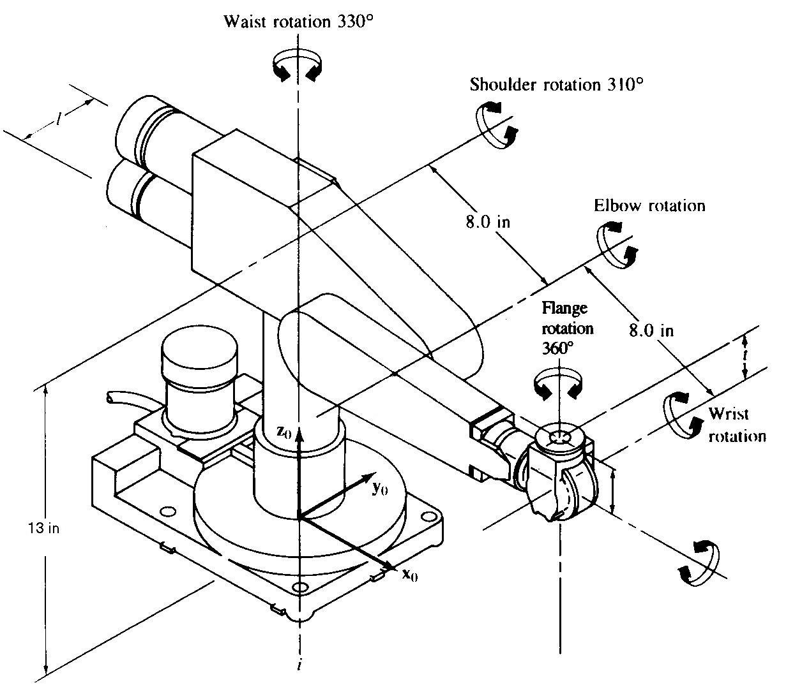































Example II: PUMA 260
Number the joints
Establish base frame
Establish joint axis Zi
Locate origin, (intersect. of Zi & Zi-1) OR (intersect of common normal & Zi )
Establish Xi,Yi
t
PUMA 260

Slide 15









Link Parameters
J
1
-90
0
13
2
0
8
0
3
90
0
-l
4
-90
0
8
5
90
0
0
6
0
0
t
: angle from X_{i-1} to X_{i}
about Z_{i-1}
: angle from Z_{i-1} to Z_{i} about X_{i}
: distance from intersection
of Z_{i-1} & X_{i} to Oi along X_{i}
Joint distance : distance from Oi-1 to intersection of Z_{i-1} & X_{i} along Z_{i-1}

Slide 16
Transformation between i-1 and i
Four successive elementary transformations are required to relate the i-th coordinate frame to the (i-1)-th coordinate frame:
  Rotate about the Z _{i-1} axis an angle of θ_{i} to align the X _{i-1} axis with the X _{i} axis.
  Translate along the Z _{i-1} axis a distance of d_{i}, to bring X_{i-1} and X_{i} axes into coincidence.
  Translate along the X_{i} axis a distance of a_{i} to bring the two origins O_{i-1} and O_{i} as well as the X axis into coincidence.
  Rotate about the X_{i} axis an angle of α_{i} ( in the right-handed sense), to bring the two coordinates into coincidence.

Slide 17
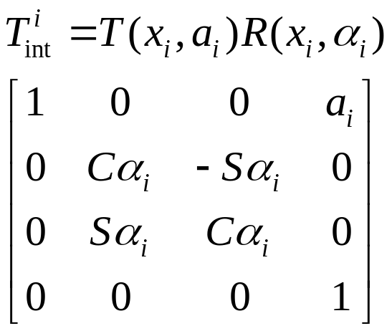
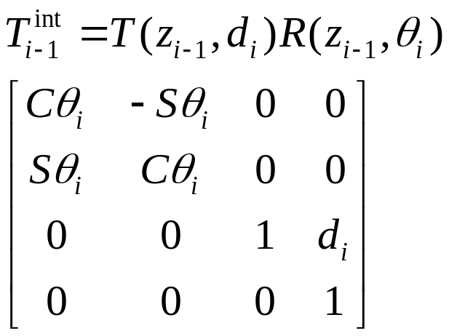
Denavit-Hartenberg Notation

Slide 18
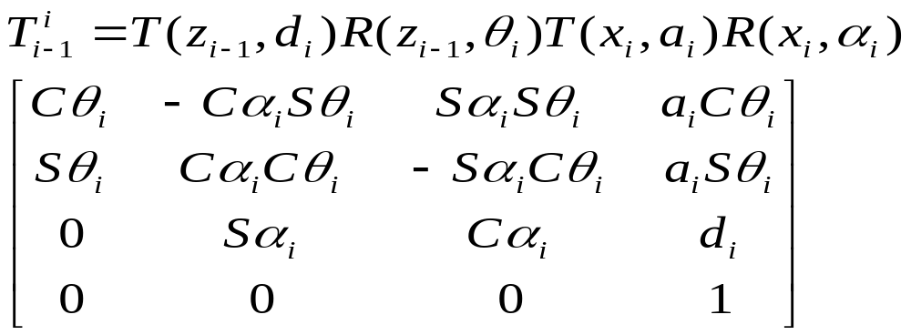
Transformation between i-1 and i
D-H transformation matrix for adjacent coordinate frames, i and i-1.
  The position and orientation of the i-th frame coordinate can be expressed in the (i-1)th frame by the following homogeneous transformation matrix:
Source coordinate
Reference
Coordinate

Slide 19

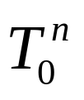
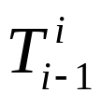
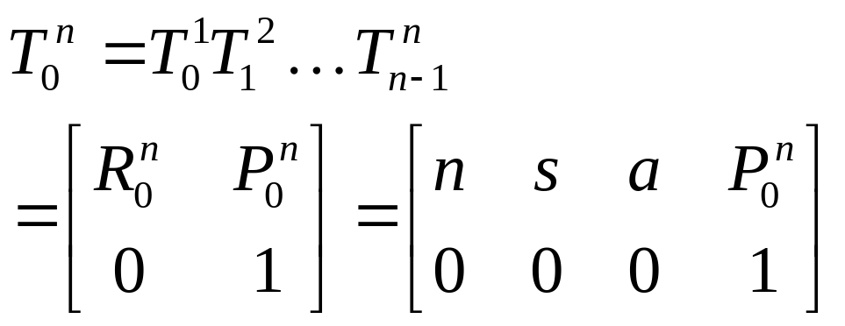
Kinematic Equations
Forward Kinematics
  Given joint variables
  End-effector position & orientation
Homogeneous matrix
  specifies the location of the ith coordinate frame w.r.t. the base coordinate system
  chain product of successive coordinate transformation matrices of
Position vector
Orientation matrix

Slide 20
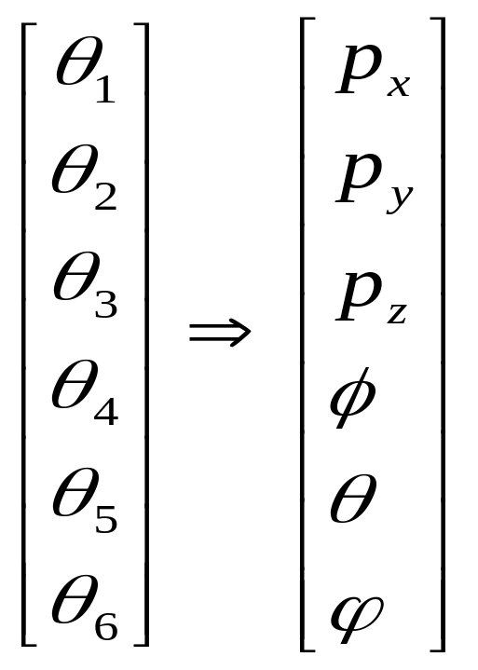
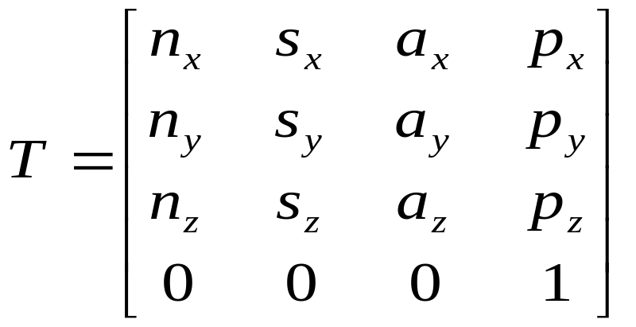
Solving forward kinematics
Forward kinematics
Transformation Matrix

Slide 21
Kinematic Model
Steps to derive kinematics model:
  Assign D-H coordinates frames
  Find link parameters
  Transformation matrices of adjacent joints
  Calculate Kinematics Matrix
  When necessary, Euler angle representation

Slide 22
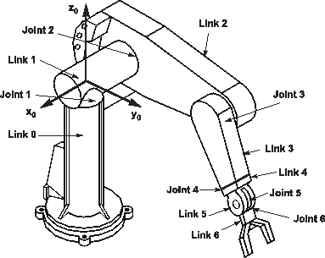
Example: Puma 560

Slide 23
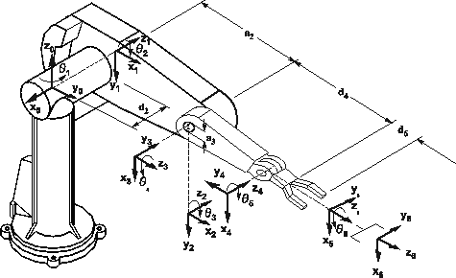
Example: Puma 560

Slide 24
Example: Puma 560

Slide 25
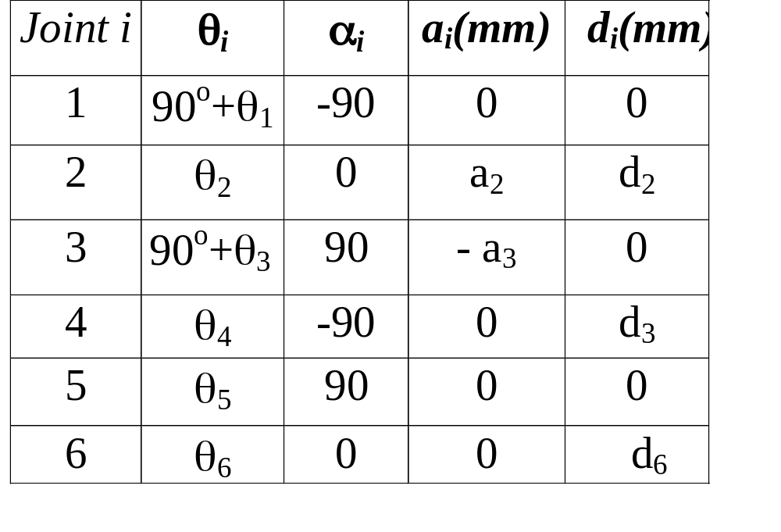
Link Coordinate Parameters
PUMA 560 robot arm link coordinate parameters

Slide 26






Example: Puma 560

Slide 27

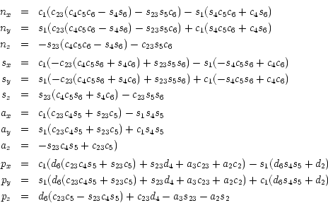
Example: Puma 560

Slide 28

Inverse Kinematics
Given a desired position (P) & orientation (R) of the end-effector
Find the joint variables which can bring the robot the desired configuration

Slide 29
Inverse Kinematics
More difficult
  Systematic closed-form solution in general is not available
  Solution not unique
    Redundant robot
    Elbow-up/elbow-down configuration
  Robot dependent
l₂
(x , y)
l₂
l₁
l₁

Slide 30
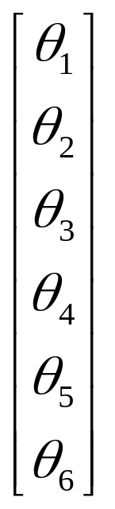
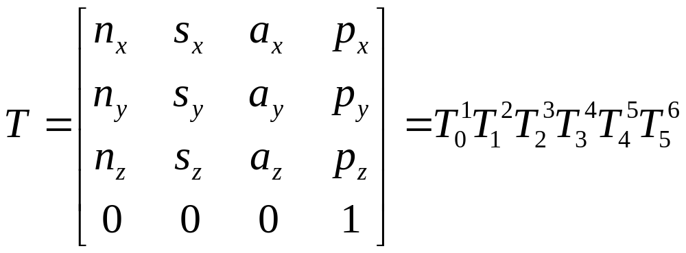
Inverse Kinematics
Transformation Matrix
Special cases make the closed-form arm solution possible:
Three adjacent joint axes intersecting (PUMA, Stanford)
Three adjacent joint axes parallel to one another (MINIMOVER)

